Slide 1
Some internet usage statistics
Statcounter Global Stats

Slide 2
Statcounter Global Stats
https://gs.statcounter.com/
Registers page views
Past year
Belgium
General view
Your target audience may vary
(But you can use tools such as Google Analytics, Hotjar …)
Notes:
Why is this important? Why did I choose this topic?
There is a lot of hype, there is fake news, we all live in bubbles of similar people … belief is not always the same as that which is true.
If you invest limited resources (time, money) in the next big thing, you can no longer invest these same resources to follow a different path
You may end up missing out on a lot of money

Slide 3
What type of device do people use?
Notes:
Does anyone have an idea? How is usage distributed over mobile, tablet and desktop usage?
! 1 persoon per vraag

Slide 4
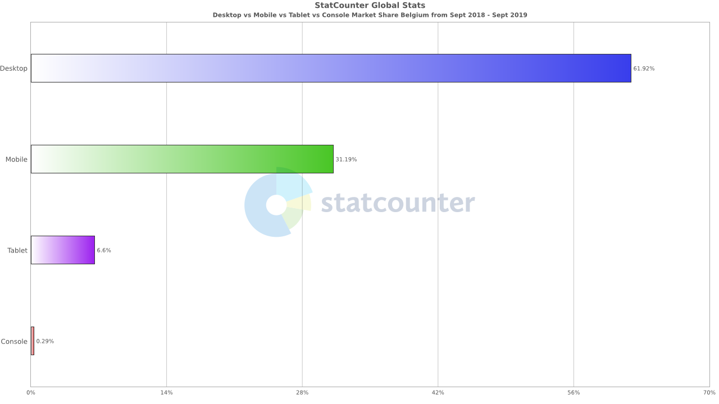
Notes:
-> Lijnen aanduiden, grafieken bespreken
In Belgium we still use laptops and desktops to surf the web.
Tablets are used a lot less
It is also possible to use gaming consoles, but their market share is very small
Nevertheless it is important to point out that a lot of people navigate their devices without a mouse cursor.
How is this relevant to us?
Did you ever try to open a link on your smartphone and ended up opening the wrong thing?
-> Some more whitespace around links would resolve this issue
The past week end, I was looking for a second hand bicycle on my phone. I wanted to filter the search results so that I would only see the bikes that are suitable for me. But it was impossible to check the right boxes. You can lose potential customers this way.
-> Bigger check boxes would have helped

Slide 5
Which browser do they use?
Notes:
Someone give me a distribution of percentages

Slide 6
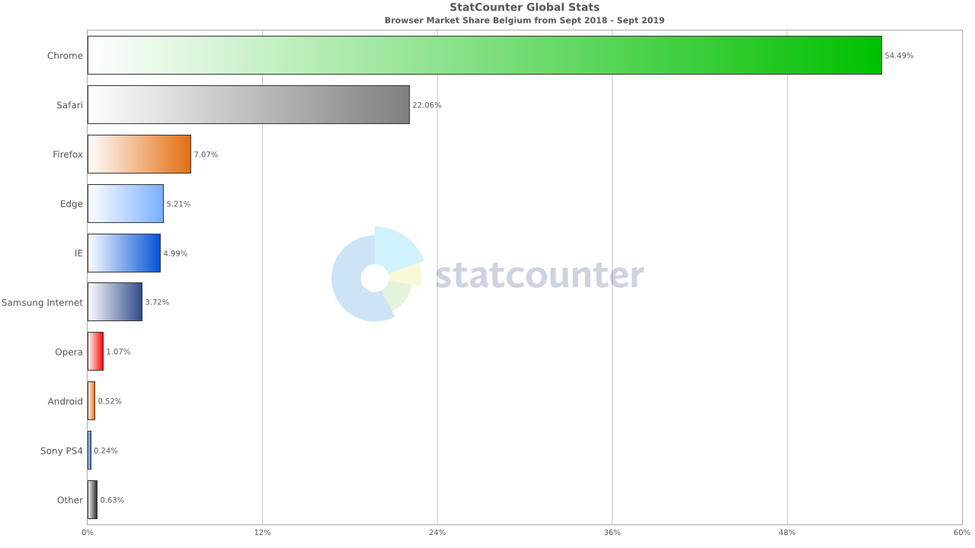
Notes:
Chrome dominates the market, closest second is Safari with 20% of the page views
By the way, if we would segment this data further, we would see that Safari dominates the tablet market
How is this practical info?
Take for instance video formats. .ogg is not supported by Safari.
-> If you decide to service Safari users, you can upload the same video file in a format that is supported. The browser used will go through the list of video files that you have provided and you can even display a message to inform people that they may want to visit the page using another browser to view the video
-> Another example is the use of webkits. These bits of codes function as patches so that your code can be correctly viewed on browsers that would otherwise not display it correctly

Slide 7
What is their screen resolution?
Notes:
Does anyone have any idea?

Slide 8
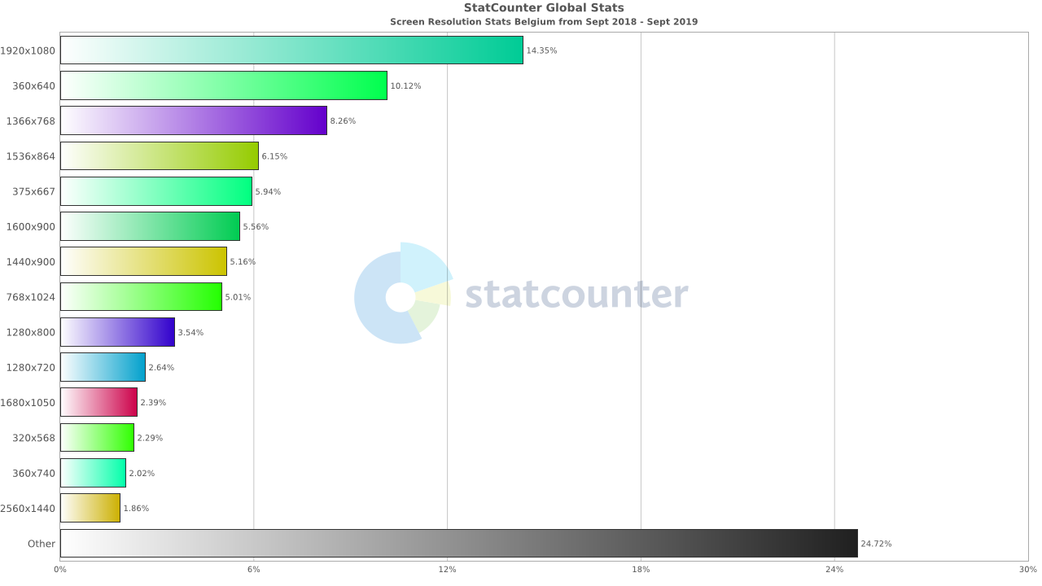
Notes:
This is a difficult one and it is difficult, because there is no easy answer
There is a great variety of screen resolutions. I think it says a lot that 25% of the page views take place on screens that don’t make the top-15 of resolutions.
A lot has to do with the different devices used.
How is this important?
Your screen is not your visitor’s screen. That your site looks good on your screen doesn’t mean that your audience will agree.
-> You can try to manage this by using media query’s in your CSS.

Slide 9
Which search engine is used most often?
Notes:
This one may be too easy. Perhaps someone wants to guess what the market share of Internet Explorer is?

Slide 10
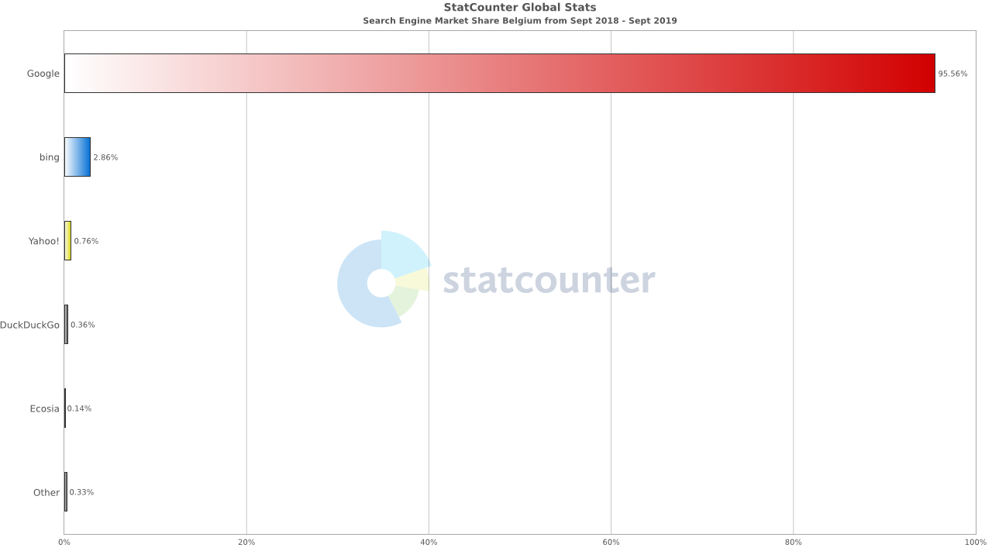
Notes:
Big surprise: Google dominates the searches
Why should we care?
Both Google and Bing offer guidelines to rank well in the search results. You may want to look more into the Google SEO guidelines and may want to pay close attention to the titles and descriptions that appear on the search engine results page

Slide 11
Take-away’s
Get to know your audience by collecting user data
Your experience is not necessarily the experience of your site’s visitors
When writing code, pay attention to such things
Browser-specfic requirements
Navigation by way of one or more fingers
How Google evaluates your pages
…
Test

Slide 12
Questions? Additions? Corrections?
Notes:
(ik zal niet alles weten)

